Slide 1
SKINALYZER: AI-BASED SKIN CANCER DETECTION SYSTEM
202011039 Bekir Emrehan Şimşek
202011013 Melike Hazal Özcan
202011407 Bilgesu Fındık
202011048 Pelin Koz
Advisor: DR. Ayşe Nurdan SARAN

Slide 2
Contents
Problem
Analysis
Solution
Results and Conclusion
Demo
References

Slide 3
Problem
What is our aim?
Main Problems

Slide 4
What is our aim?
Effective, Scalable, and Privacy-Focused
Simple Navigation, No Medical Jargon
Accessible platform for everyone.
No need to understand complex medical terminology.
Fast and Accurate Insights
Obtain early diagnosis results quickly.
High accuracy for informed decision-making
Enhancing Healthcare Access
Shorten waiting times for hospital appointments.
Empower early detection and timely action.

Slide 5
Main Problems
Early Skin Cancer Diagnosis
Data Privacy
Continuous Learning
Lack of User-Friendly Interface

Slide 6
Analysis /Possible Solutions
Combined Approach: Incremental Learning and Federated Learning
Contribution: Advancing Skin Cancer Detection with AI

Slide 7
Combined Approach: Incremental Learning and Federated Learning
Paper Name | Image Processing | Metrics | Incremental Model | Federated Learning
Incremental learning and Federates Learning for Heterogeneous Medical Image Analysis [1] | Traditional Deep Learning and CNN | CCSI accuracy: 79.10% (BloodMnist Dataset) FeImpres (Medical init): 94.2% (a=0.01 epoch=5 BloodMNIST Dataset) FedImpres w constrained CE loss: 80.6% (a=0.005, epoch=10,Retina Dataset) | Continual Normalization model structure to restore Continual Class-Specific Impression | FedCurv for Catastrophic Forgetting, Transfer Learning, FedImpress
Thesis Overview
Focuses on enhancing the adaptability of deep learning (DL) models in real-world medical imaging settings, characterized by heterogeneous and sensitive data.
Combines incremental learning and federated learning to address key challenges: continuous learning of new disease classes and preserving patient data privacy across institutions.

Slide 8

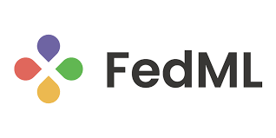

Contribution: Advancing Skin Cancer Detection with AI
Incremental Learning
Adds new knowledge without forgetting old.
Federated Learning
Protects patient privacy with decentralized training.
Impact
Accurate, scalable, and secure skin cancer diagnosis.

Slide 9
Solution
HAM10000 Dataset (Human Against Machine)
ISIC 2019 Dataset
Architectural Diagram
Technologies We Will Use

Slide 10
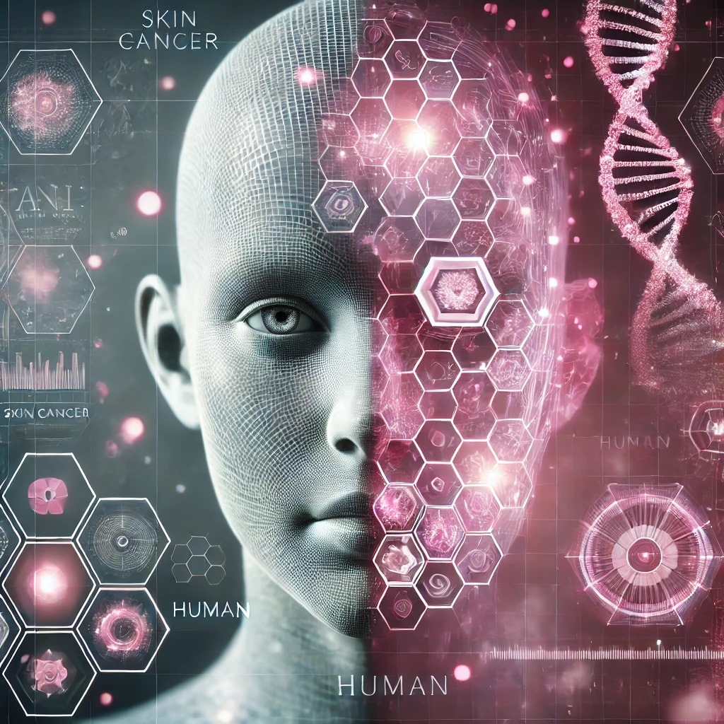
Solution
Build desktop application for skin cancer diagnosis
How are we going to do all this ?

Slide 11
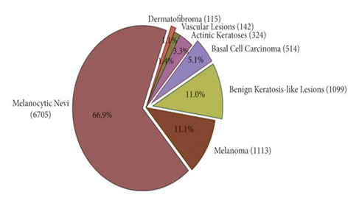
HAM10000 Dataset (Human Against Machine)
Contains over 10,000 skin lesion images

Slide 12
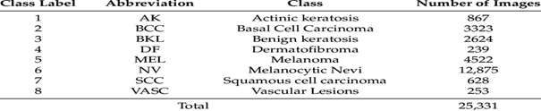
ISIC 2019 Dataset
Includes over 25,000 skin lesion images
Larger than HAM10000 dataset
Has 8 classes

Slide 13




Technologies We Will Use
Python
PyTorch for Incremental Learning
Flower framework for Federated Learning
Pandas
Numpy
Kafka-ML
MLFlow
PyQt5
MySQL

Slide 14
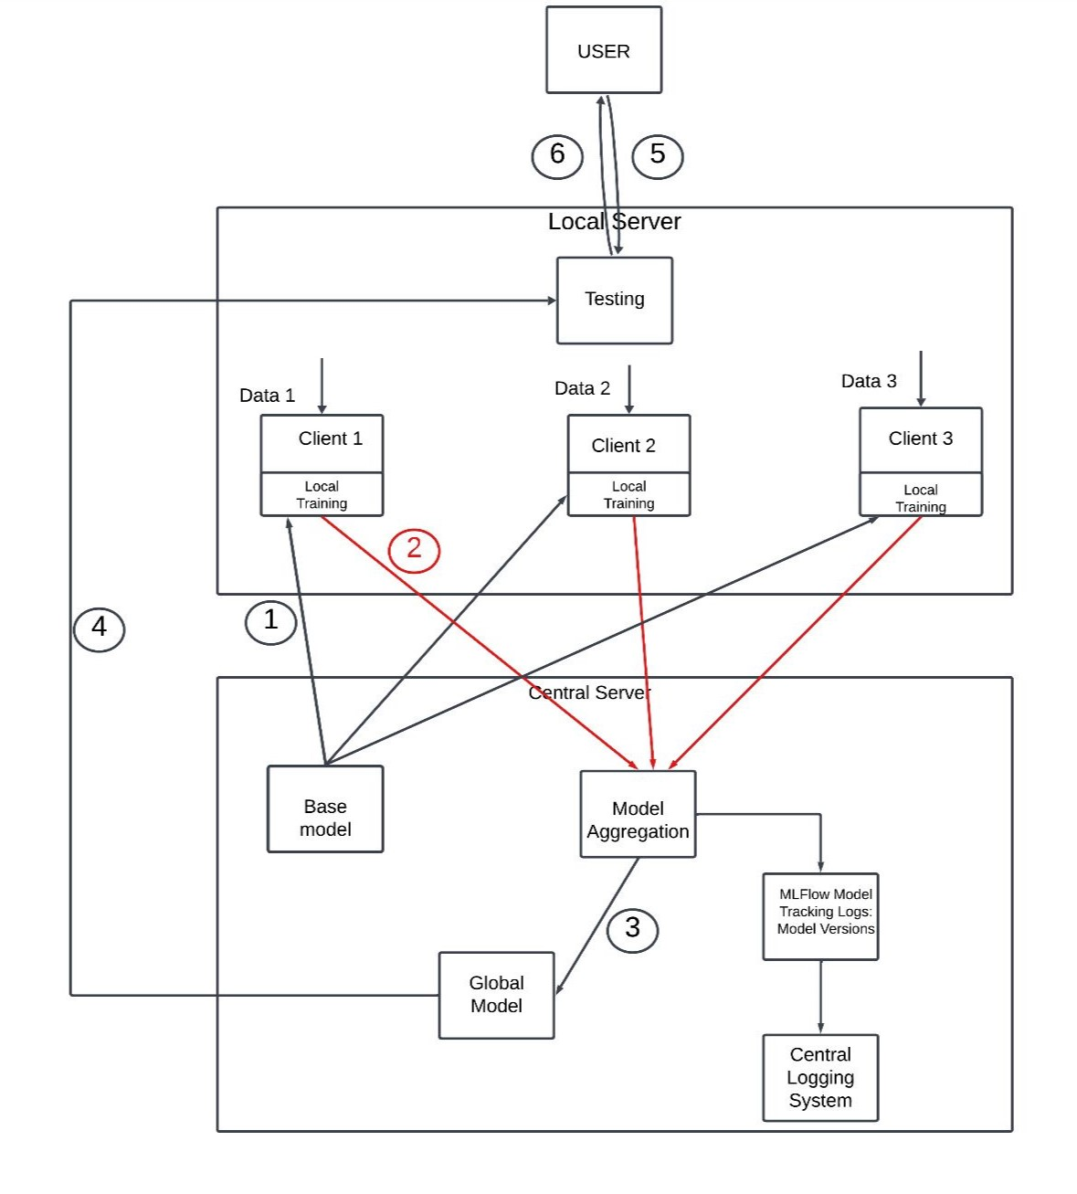
Architectural Diagram
Step 1: Base Model Creation
Step 2: Local Training
Step 3: Model Aggregation
Step 4: Sent Global Model for Testing Phase
Step 5: Testing with User Input
Step 6: Result and Threshold Control
if threshold is full
Go to Step 2
else
Go to Step 5

Slide 15
Results and Conclusions

Slide 16
Results and Conclusions
Model Development
Combines Federated Learning (FL) and Incremental Learning (IL) for skin cancer detection.
Trained on ISIC 2019 and HAM10000 datasets to improve lesion recognition.
Privacy & Security
Local data processing ensures privacy using Kafka-ML.
Encrypted communication minimizes risks.
Continuous Learning
IL prevents catastrophic forgetting while integrating new data.
Adaptable and continuously updated for improved performance.
High Performance
90%+ accuracy and efficient detection system.
FL reduces central server load, supporting multiple devices.
Visual Tips:
Use icons for privacy, accuracy, and adaptability.
Add a flowchart or graphic showing FL and IL integration.

Slide 17
Demo

Slide 18
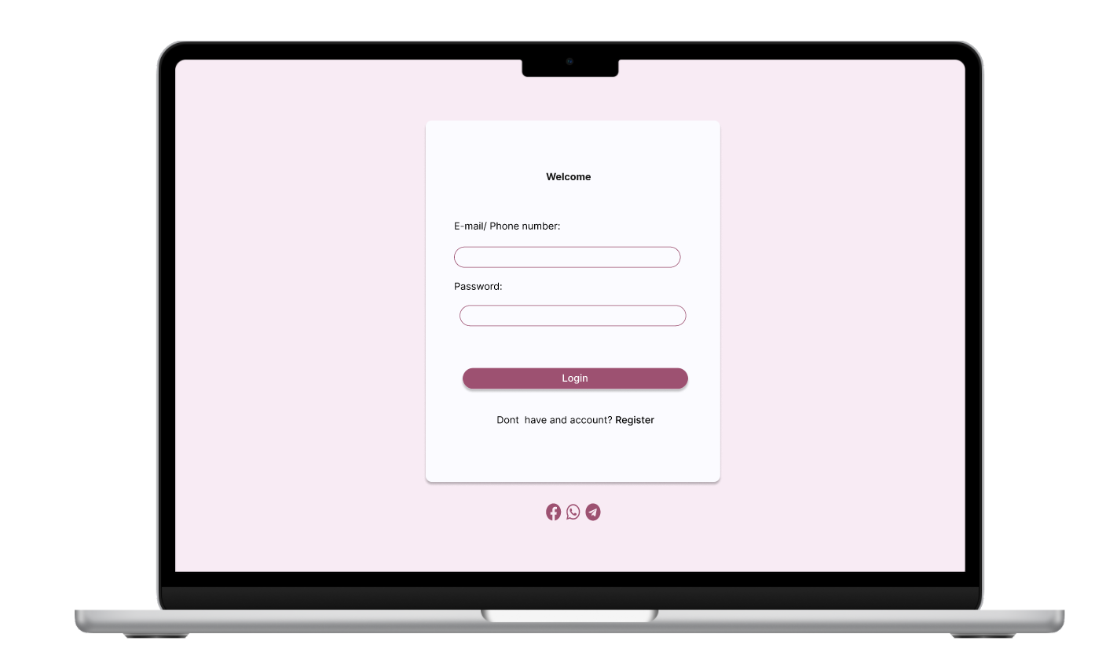

Demo
Login Page
Register Page

Slide 19
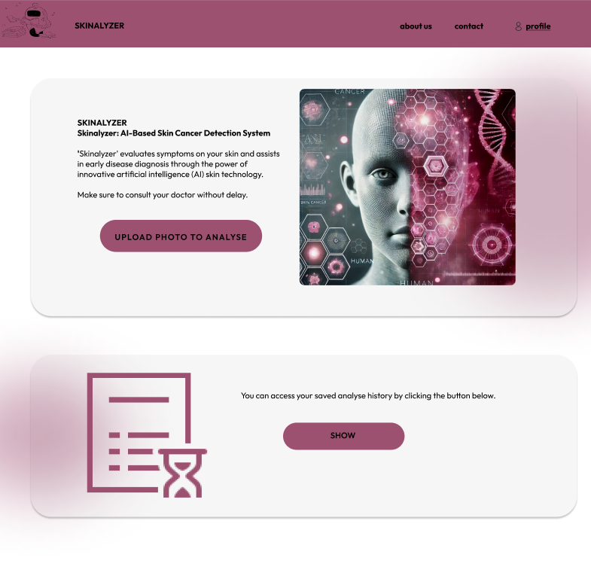
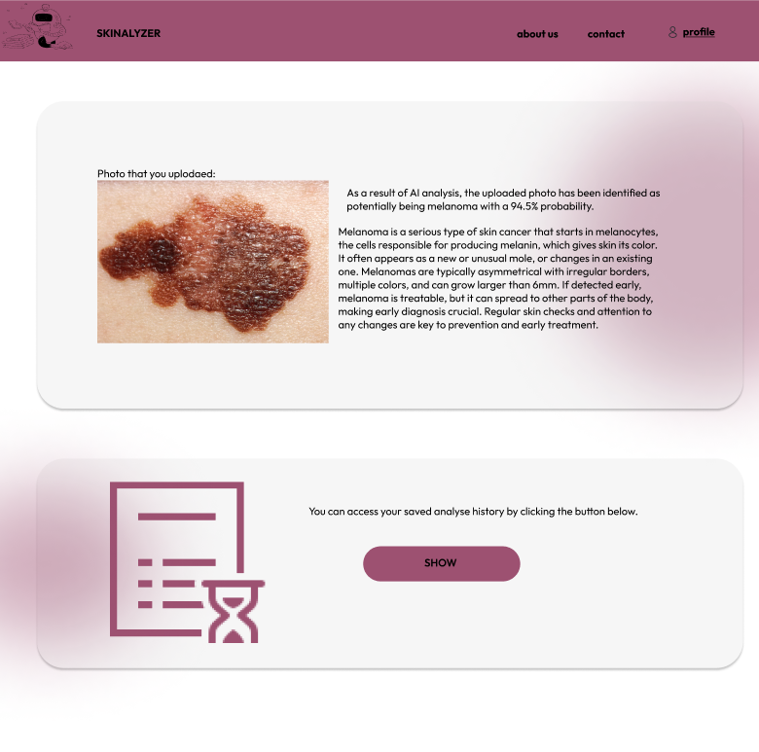
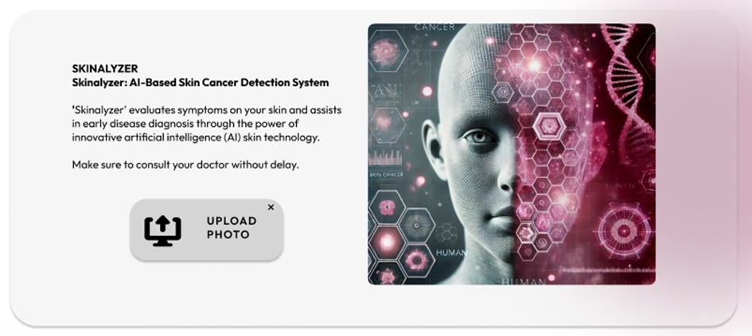
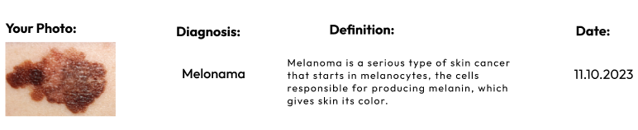
Home Page

Slide 20
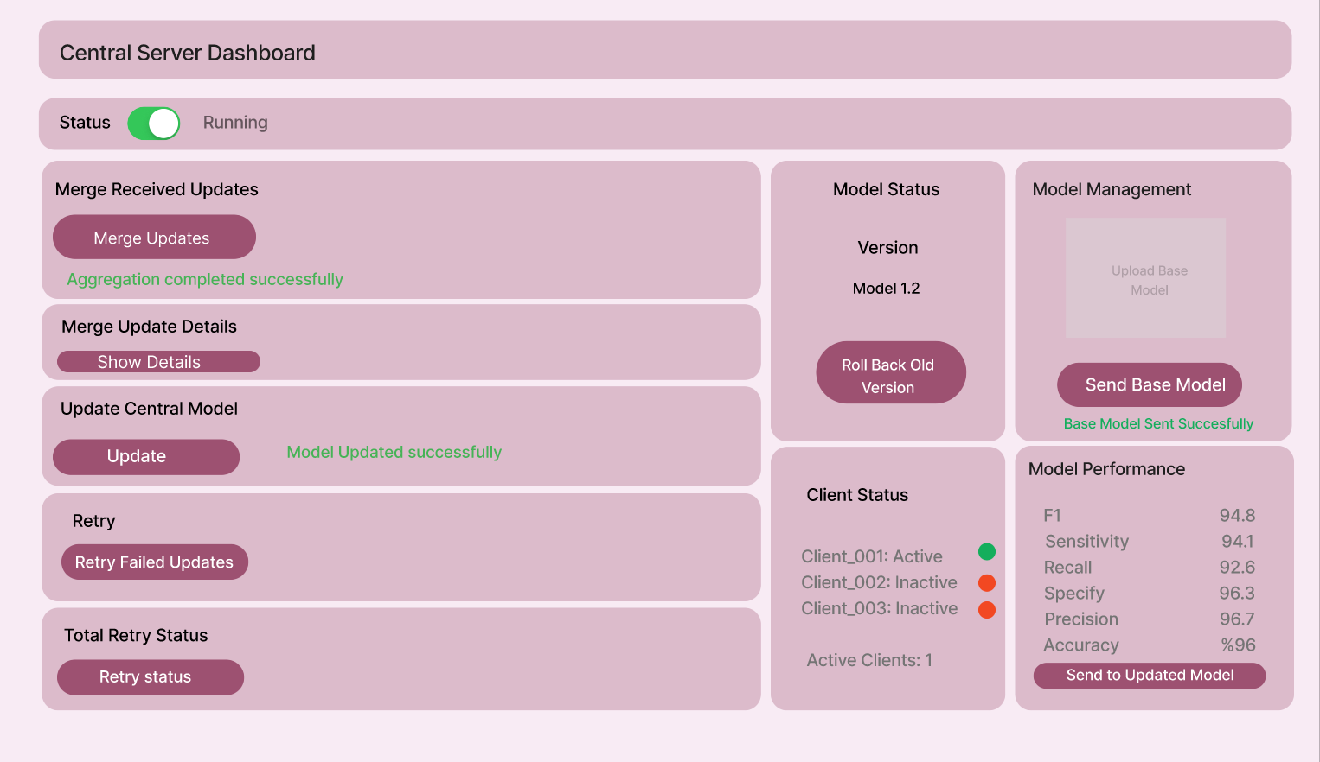
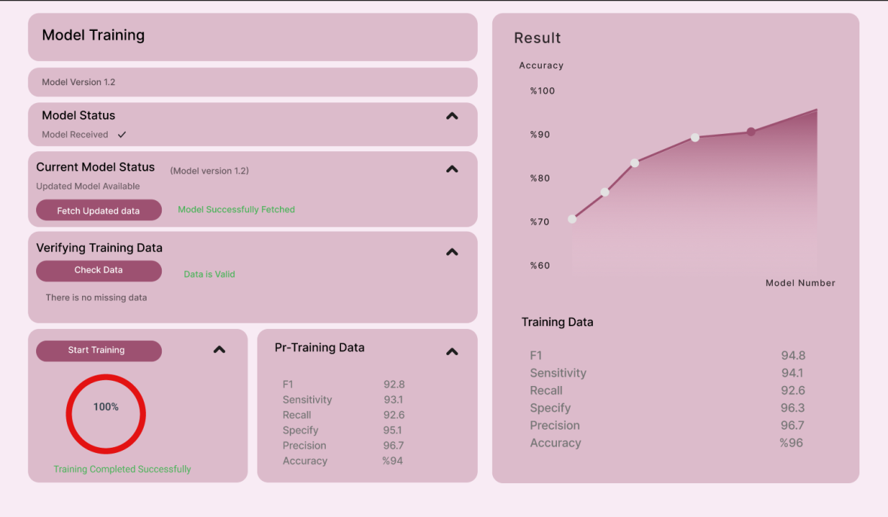
Server UI
Client UI

Slide 21
Thank You

Slide 22
References
Ayromlou, Sana. Incremental learning and federated learning for heterogeneous medical image analysis. Diss. University of British Columbia, 2023. [1]

